Slide 1
Ember Information Technology Environment: Progress Report, 4 December 2018

Slide 2
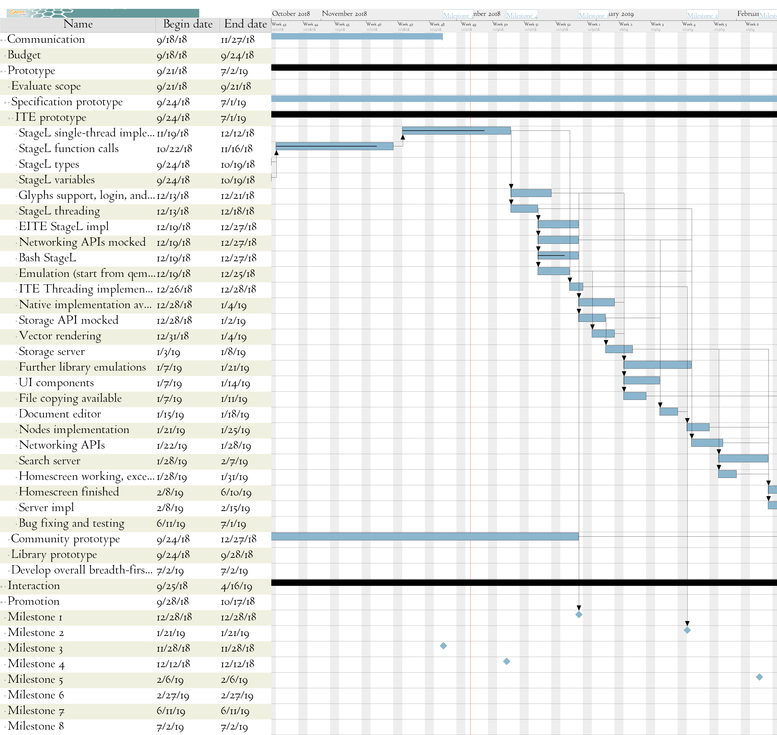

Slide 3
Project introduction
A way of representing information as a series of elements
Increasing flexibility of software by representing different kinds of information the same way

Slide 4
Project introduction
An example
  A computer understands the word “Hello” as a series of 5 numbers, each corresponding to a letter.
  That is simple, but what if we want the “H” to be italicized?
* (A few things in this introduction aren’t strictly true.
I’m trying to keep it simple, so bear with me :)

Slide 5
Project introduction
Italics needs another format, like HTML.
For instance, in HTML it would be
<em>H</em>ello
which a computer understands as 14 numbers.
A special computer program — a Web browser — is needed to understand that.

Slide 6
Project introduction
So, suppose we’ve got our “Hello”, with the italic H, open in a Web browser
What if we want to copy and paste that as the title of a file?
It will be turned into “Hello” — the italic is lost!
That’s because HTML isn’t possible in file names.

Slide 7
Project introduction
This project solves that:
By making “start italic” and “end italic” be simple numbers to the computer
Just like the letters are.

Slide 8
Project introduction
Existing software wouldn’t understand these numbers
So, I’m trying to create new software that does.

Slide 9
Project status
This is a lot of work!
But, I care about it.

Slide 10
Project status
The first main goal is to create software that can take numbers, and display the corresponding document.
This exists, but I want:
  Easy to work on the software
  Easy to change what numbers it understands
  Software able to use in many types of computer

Slide 11
Project status
For that third goal — portable between many computers — I want a “domain-specific language” (DSL).
This is a way for me to build the software once, and have it work in lots of type of computers.

Slide 12
Project status
The DSL is simpler than a normal “programming language” (a way to express a program)
Since it’s simpler, it’s easier to make it work
  Mine is automatically converted to other programming languages
  Right now, it’s converted to the “JavaScript” programming language, which can run in Web browsers
  I can make it convert to other programming languages

Slide 13
Project status
The DSL is a tool made for building this project
So, it is particularly suited for it
  It doesn’t try to express other kinds of software
  That means it should be nicer for this project

Slide 14
Project status
I am working on the DSL now
I already have software that understands some of these new meanings of numbers
It is expressed using JavaScript
Soon, I can work on it by expressing it in the DSL and having the JavaScript made automatically
That will be easier for me

Slide 15
Project status
The DSL’s parser is finished (assuming I don’t find any bugs) and works very well
The DSL’s code generator is very buggy
  I think I implemented it in a way that is bug-prone:
  specifically, as a bunch of state machines — they
  interact in hard-to-understand ways.
  I want to try to make that code less spaghetty.

Slide 16
Project status
Then, my work will be:
Making a greater range of things expressible by these numbers
Creating demonstrations that explore the resulting possibilities

Slide 17
For right now
You can try putting in a program in the domain-specific language yourself!
It will produce the equivalent JavaScript.
Thank you for your thoughts and feedback!

